Slide 1

Engineering Ethics
Professionalism, Codes of Ethics, Ethical Problem Solving, and Case Studies
@ Ruoxing Gao

Slide 2
Overview of Ethics
Engineers interact with the world and can affect it greatly
Ethical behavior is very personal, and will drive your decision making
In addition to technical problem solving, you have ethical problems too
Ethics and the Law do not always align
Have to balance the two in our work (and life)!

Slide 3
Is engineering a Profession?
An occupation is a profession if it includes [1]:
Skilled, sophisticated work that requires judgement & discretion (not automated)
There is an established formal education before membership
Specialized societies controlled by members who set & enforce standards
Significant public good results from the profession
1: “Engineering Ethics 4e.,” C. Fleddermann, Prentice Hall 2012

Slide 4
Standards: Code of Ethics
All professional societies adopt a Code of Ethics
Also a part of colleges/universities, companies, etc.
Goal: provide a framework for ethical judgement as a professional
Cannot be comprehensive or cover everything
Does not establish new ethical principles
Not a recipe for ethical behavior
Not a substitute for sound judgement
Not a legal document
A code helps the engineer to apply moral principles to the unique situations encountered in professional practice!

Slide 5
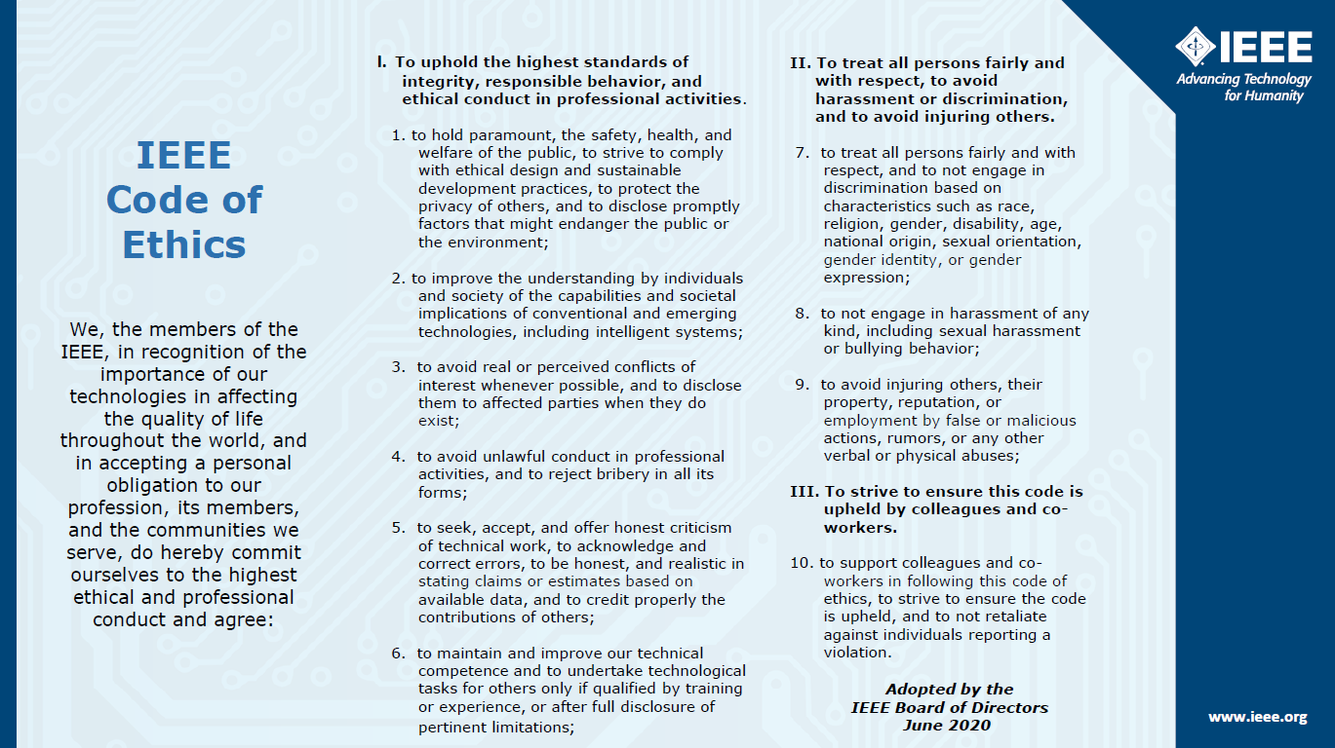

Slide 6
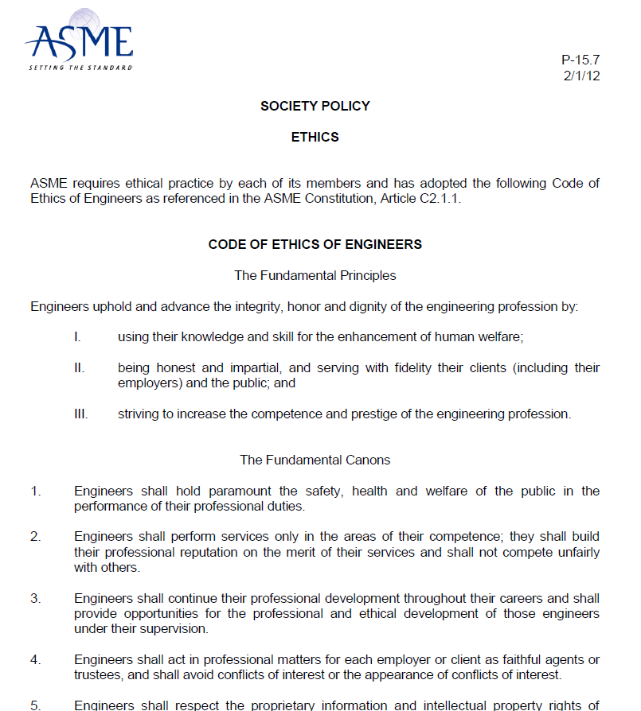

Slide 7
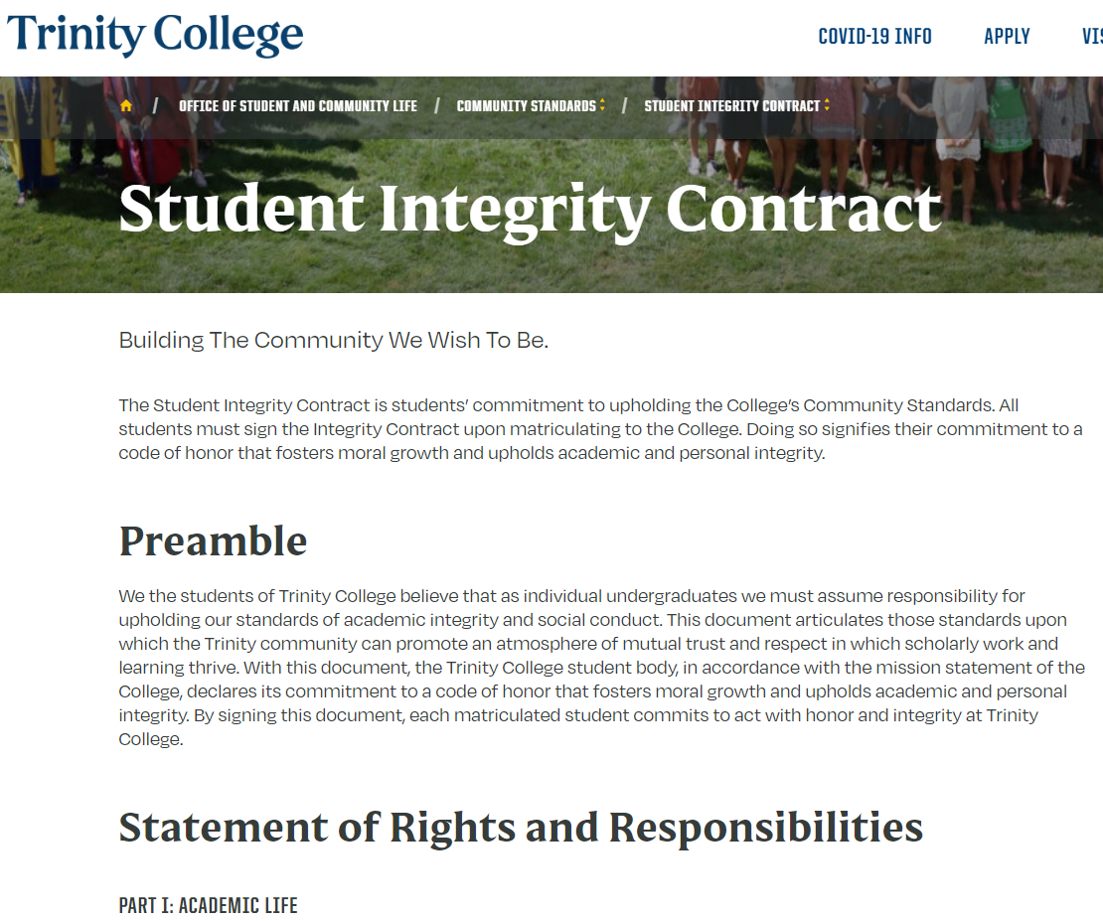

Slide 8
Ethical Problem Solving
Ethics and engineering ranges all levels of complexity:
Should you embezzle money from the company?
Should you overcharge customers and inflate contract prices?
Should you lobby for a contract and bid on a project without deep expertise?

Slide 9
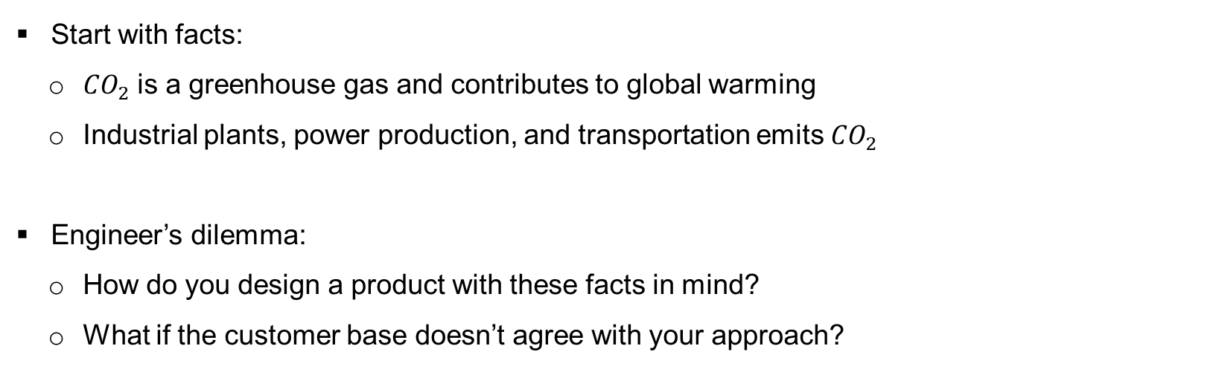
Ethical Problem Solving
Start with facts:
${CO}_{2}$ is a greenhouse gas and contributes to global warming
Industrial plants, power production, and transportation emits ${CO}_{2}$
Engineer’s dilemma:
How do you design a product with these facts in mind?
What if the customer base doesn’t agree with your approach?

Slide 10
Ethical Problem Solving
Consider the conceptual issues:
Is something a gift or a bribe?
Is an after-work meeting considered “between friends” or “inappropriate behavior?”
Which of two morally “correct” choices should you go with?
Trolley car problem – posed two ways, people cannot choose!

Slide 11
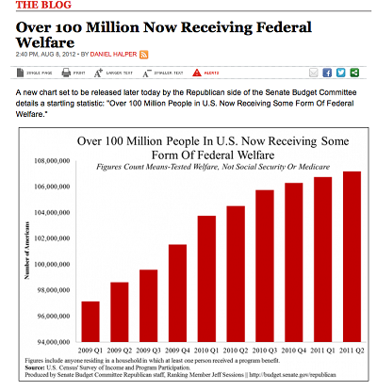
Ethical Data Analysis – Case 1
Growth of welfare payments appears to have tripled in less than 3 years!

Slide 12
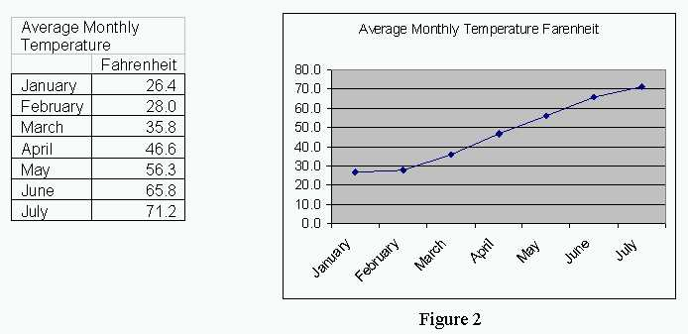
Ethical Data Analysis – Case 2
The rise in average monthly temperature is out of control!

Slide 13
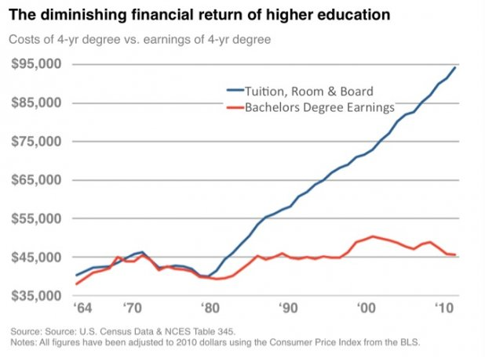
Ethical Data Analysis – Case 3
It just isn’t worth going to college anymore!

Slide 14
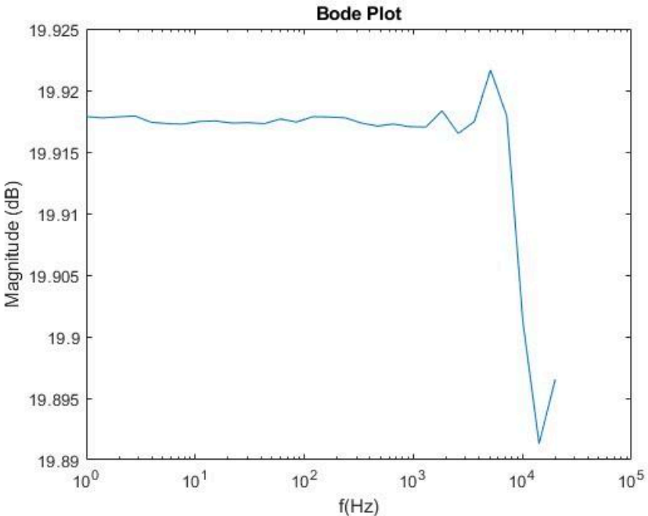
Ethical Data Analysis – Case 4
It appears that our system has a very sharp cutoff around 10 kHz.

Slide 15
Preparing for Initial Presentations
Give a 10-minute presentation on a topic of your choice:
Must address a technical topic
Must address some aspect of ethics
Must tie into some of our initial discussions/topics of lab

Slide 16
Ideas
Needs to be technical in nature – address engineering, mathematics, physics, etc.
Hobbies
Sports and the science behind it
Music and sound, whether listening or creating
Games, video or board, and their operation, construction, manufacturing
Items or ideas that address specific needs in your life
That one thing you are obsessed with and want to share with everyone
Ever watched how it’s made? Look at the complexity of the world around you!
Tie in ethics!
Find a spot where issues or dilemmas can arise
How can we use data in the correct way?
How can we draw the wrong conclusions from the data?
The fact is correct, but the interpretation is wrong

Slide 17
What Makes an Effective Talk?
Use your voice as a tool to enhance presentation
Be aware of your non-verbal communication
Prepare for your audience!
Formal setting: be professionally dressed and well-rehearsed in your message
Reflect on non-verbal communication
Use your visual aids appropriately:
Images, graphs, and charts convey information…
…but usually cannot stand on their own
Do not overcomplicate your slides with excess information – explain!
Go into detail beyond what is on the slides
Stay focused on the topic at hand: rehearse your material and know what the point of the presentation is!

